Slide 1

Grocery Store Management

Slide 2
About me
NAME : Sudheer Sagar
QUALIFICATION : B.Tech
WORK EXPERIENCE :Junior Data Service Engineer, Centific Technologies
(2022-2024)
LinkedIn : www.linkedin.com/in/sudheer-sagar
Background? (B-tech or M-tech)
Why you want to learn Data Science
Any work experience
Share your LinkedIn and GitHub profile URLs

Slide 3
Agenda (This should be the PPT flow)
Objective of the Project
ER Diagram and schema explanation
Key analysis questions (use cases)
SQL query results with screenshots or summaries
Final business insights and recommendations
Conclusion (Key finding overall)
Q&A Slide
Your Experience/Challenges working on SQL – Data Analysis Project.

Slide 4
OBJECTIVE
To design and implement a relational database for a grocery store.
To retrieve and manipulate data using SQL queries.
To perform data analysis for business insights such as top customers, best-selling products, and revenue trends.
To practice using joins, aggregations, subqueries, and filtering techniques.

Slide 5
SCHEMA
DATABASE - GROCERYSTORE
EMPLOYEES - Records employees responsible for handling customer orders.
CUSTOMERS - Contains customer details who place orders.
PRODCUTS - products Holds product information, including price, supplier, and category.
SUPPLIER - Stores information about the suppliers who provide products.
CATEGORIES - Contains the different product categories (e.g., Beverages, Snacks).
ORDERS - Logs customer orders handled by employees.
ORDER_DETAILS - Stores line items for each order, including product quantity and pricing.

Slide 6
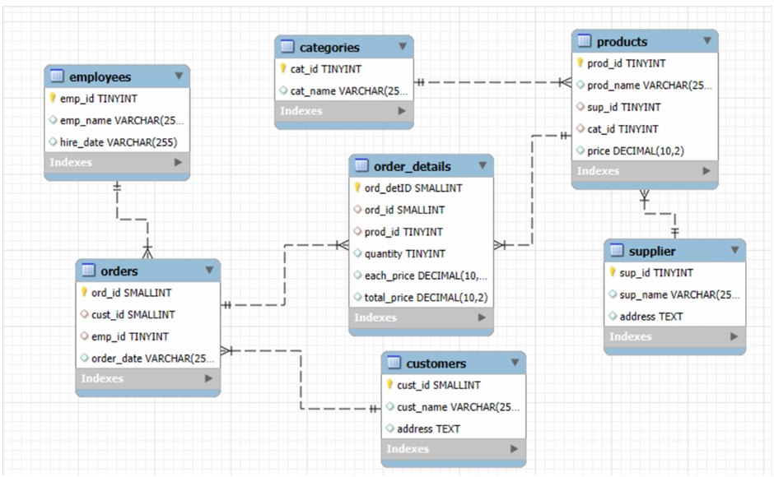
ER Diagram

Slide 7
Key analysis questions (use cases)
Customer Insights
Employee Performance
Supplier Contribution
Product Performance
Sales and Order Trends
Order Details Deep Dive

Slide 8
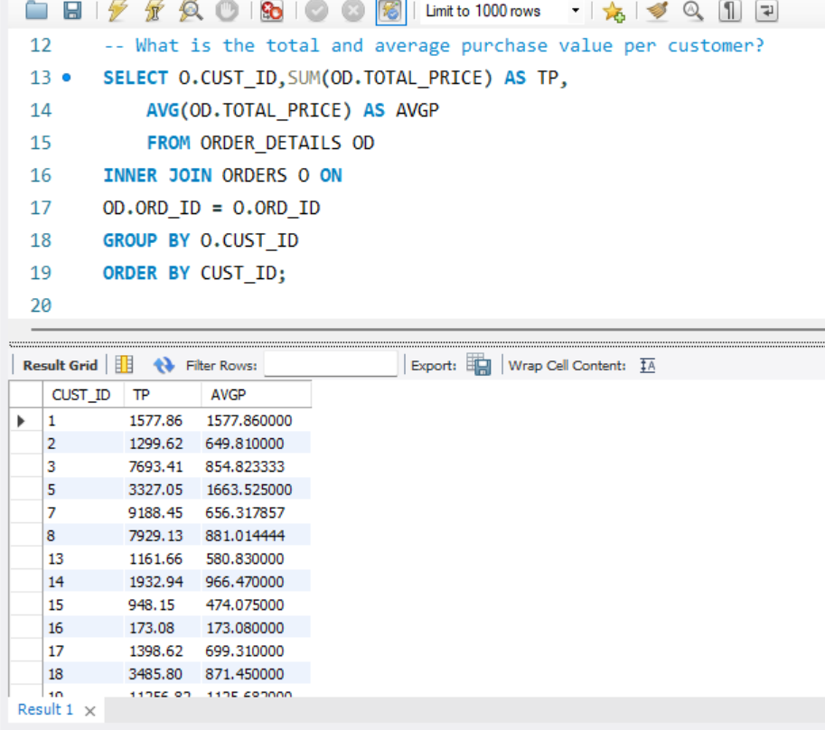
What is the total and average purchase value per customer?
To calculate the total and average purchase value per customer, you're measuring both the overall contribution of each customer and their typical spending behavior.

Slide 9
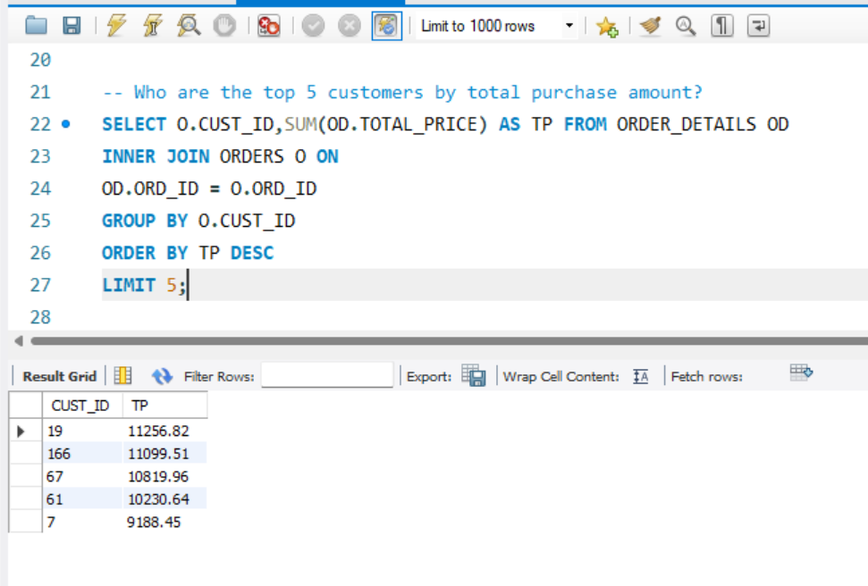
Who are the top 5 customers by total purchase amount?
To find the top 5 customers by total purchase amount, you're aggregating the total value of all purchases per customer and ranking them. This is a classic metric for identifying high-value clients and tailoring loyalty strategies.

Slide 10
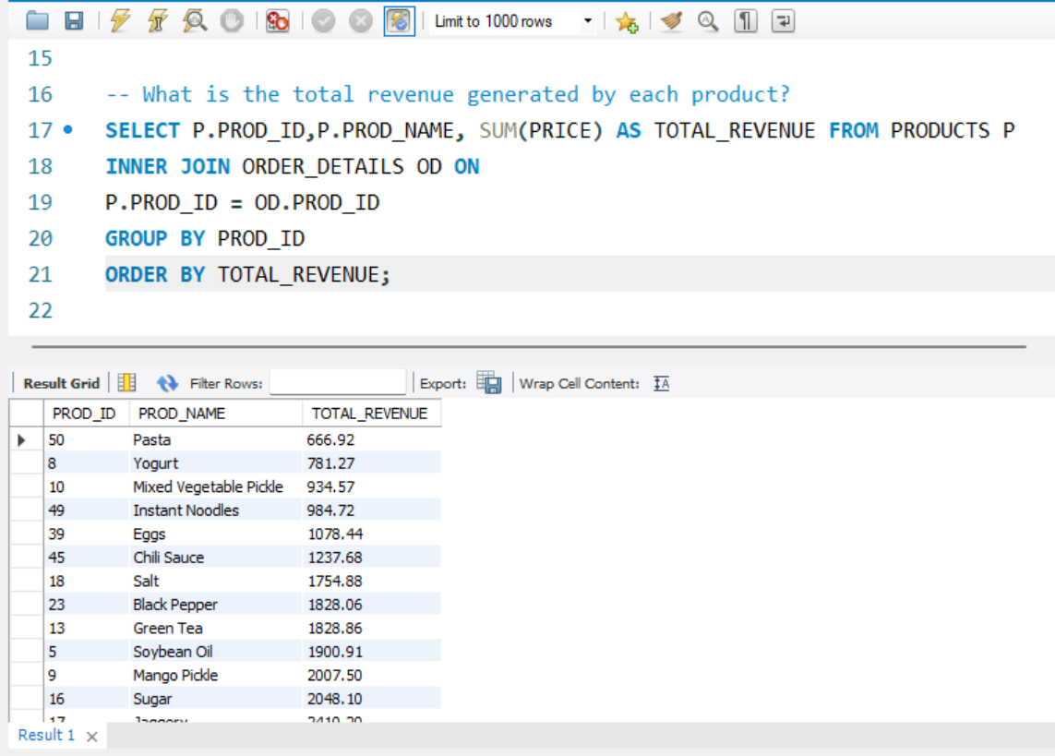
What is the total revenue generated by each product?
To calculate the total revenue generated by each product, you need to multiply the quantity sold by the unit price (adjusted for any discounts, if applicable) and sum it across all transactions. This gives about product performance most& least selling.

Slide 11
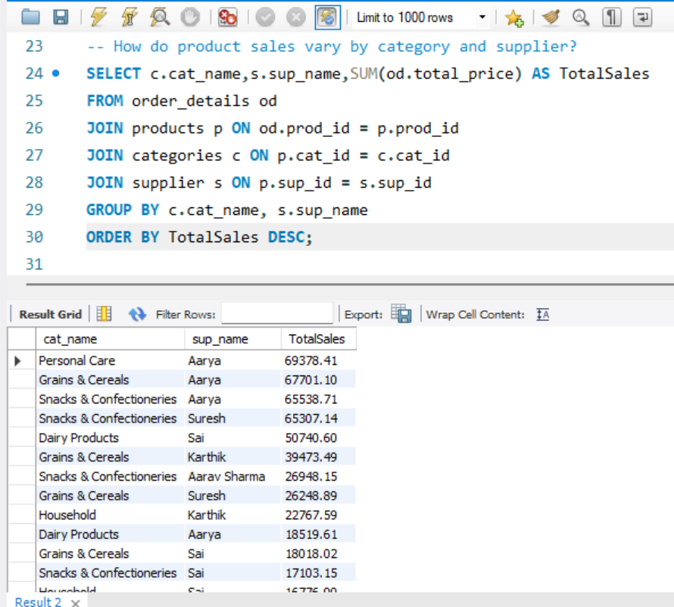
How do product sales vary by category and supplier?
To understand how product sales vary by category and supplier, you can analyze both dimensions together to uncover strategic insights
Top-Performing Categories by Supplier. So that we can buy those products from the supplier.

Slide 12
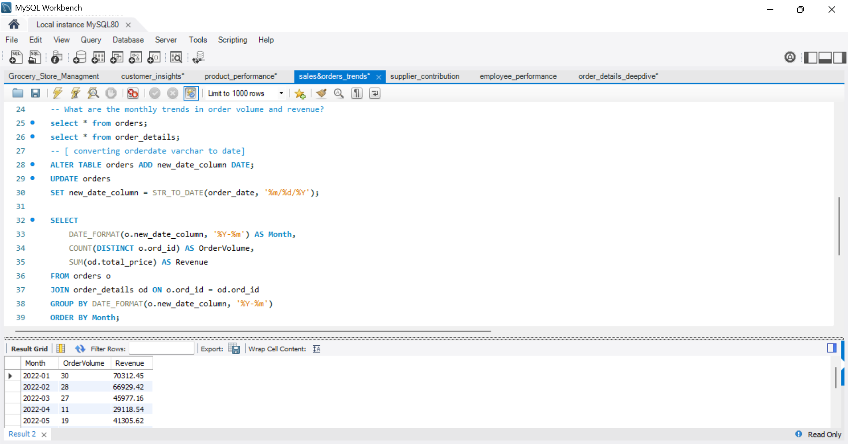
What are the monthly trends in order volume and revenue?
To analyze monthly trends in order volume and revenue, you can use SQL to group data by month and year, revealing seasonal patterns, growth rates, and customer behavior shifts.

Slide 13
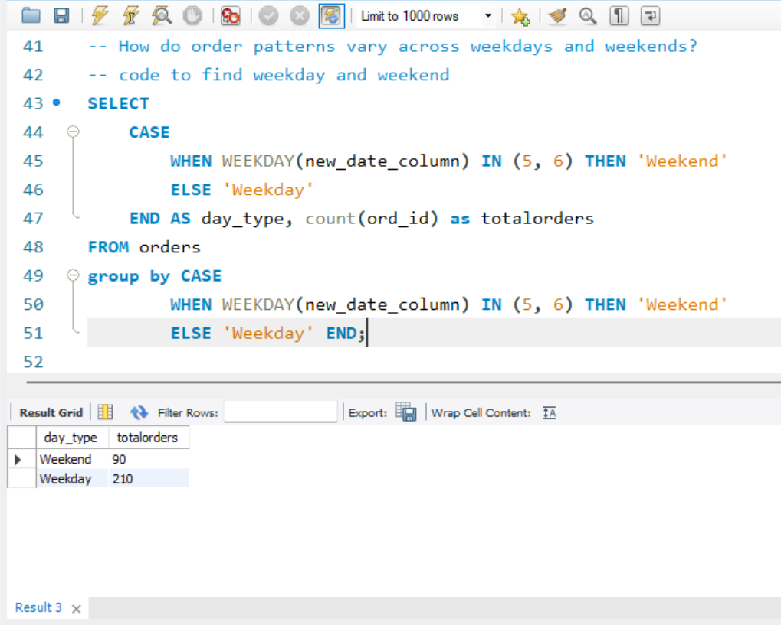
How do order patterns vary across weekdays and weekends?
Order patterns across weekdays and weekends often reveal distinct consumer behaviors and operational trends. High volume of B2B orders, consistent order flow, peak times, product types.

Slide 14
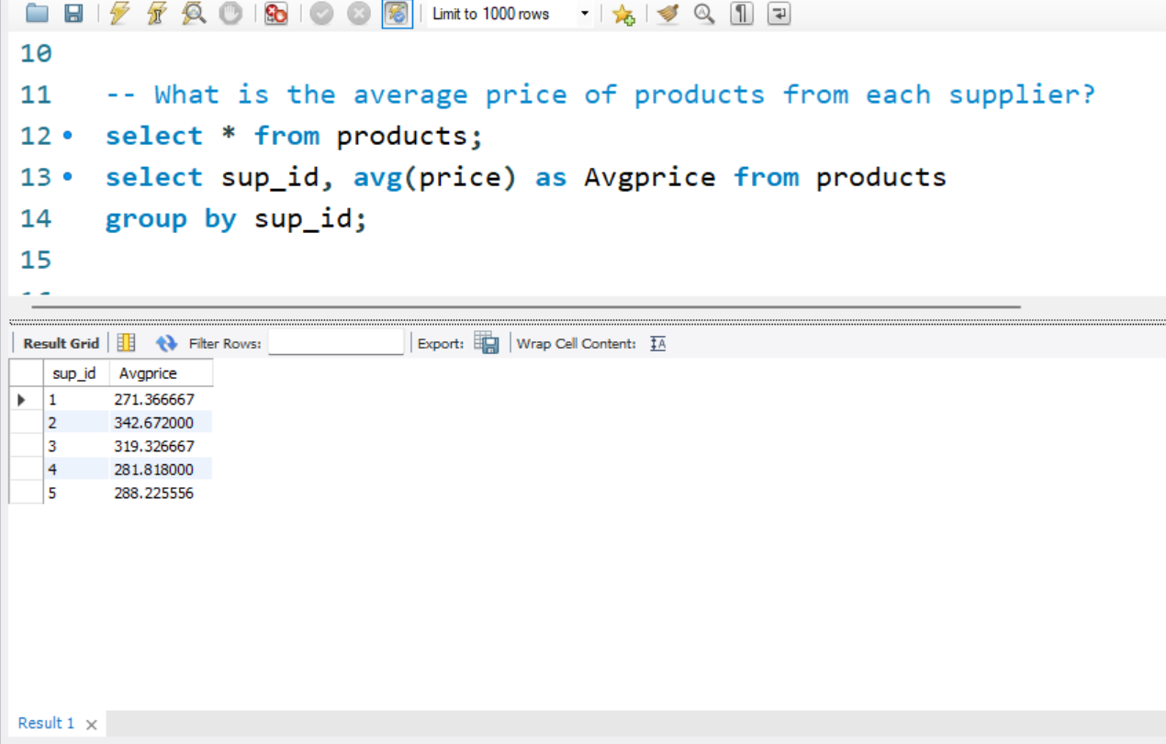
What is the average price of products from each supplier?
To find the average price of products from each supplier using SQL, you're essentially calculating the mean price of all products associated with each supplier. This helps assess pricing competitiveness and supplier positioning. Pricing strategy and cost optimization.

Slide 15
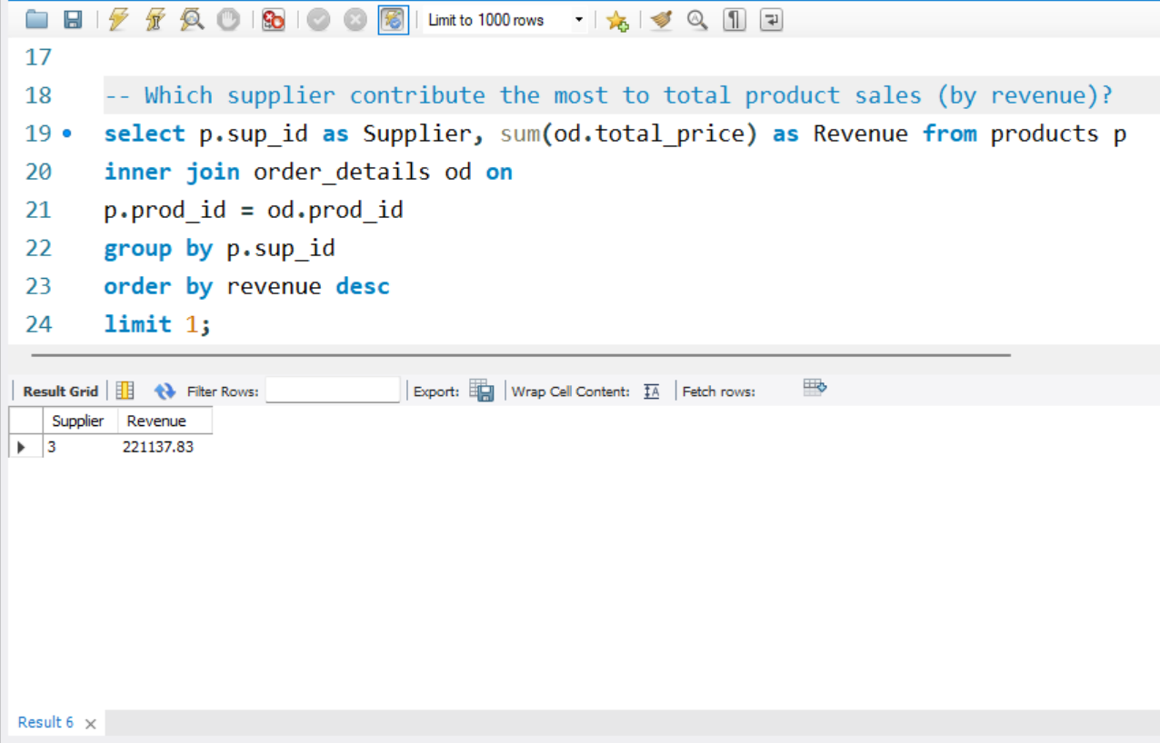
Which supplier contribute the most to total product sales (by revenue)?
To determine which supplier contributes the most to total product sales by revenue, you'd typically analyze the aggregated sales value associated with each supplier. This helps identify key partners driving your business growth.

Slide 16
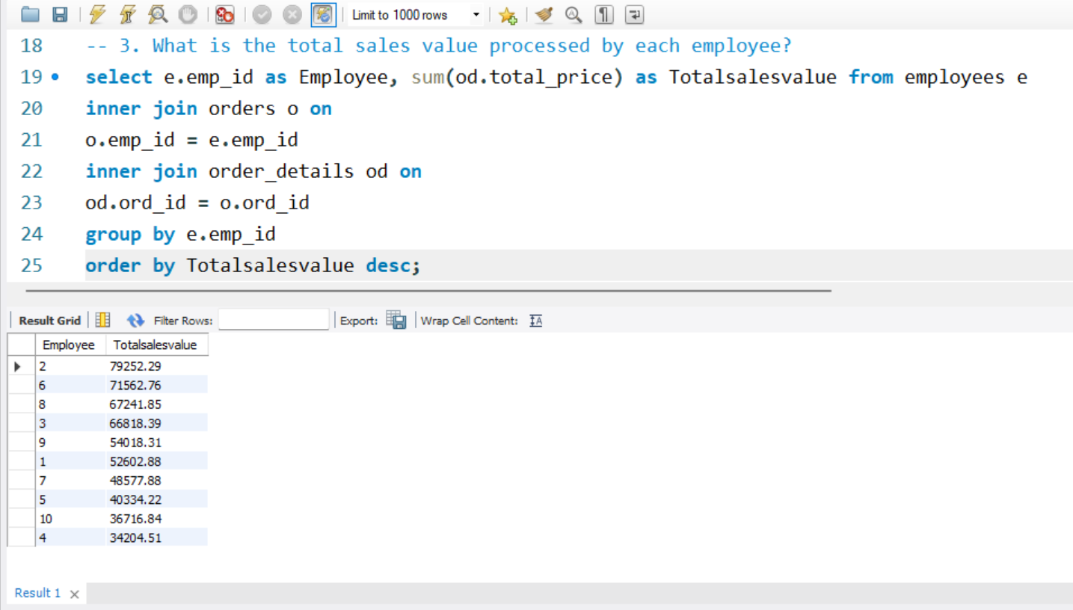
What is the total sales value processed by each employee?
To find the total sales value processed by each employee, you're aggregating the total revenue each employee has contributed to.
This is a key metric for assessing individual impact on overall sales.

Slide 17
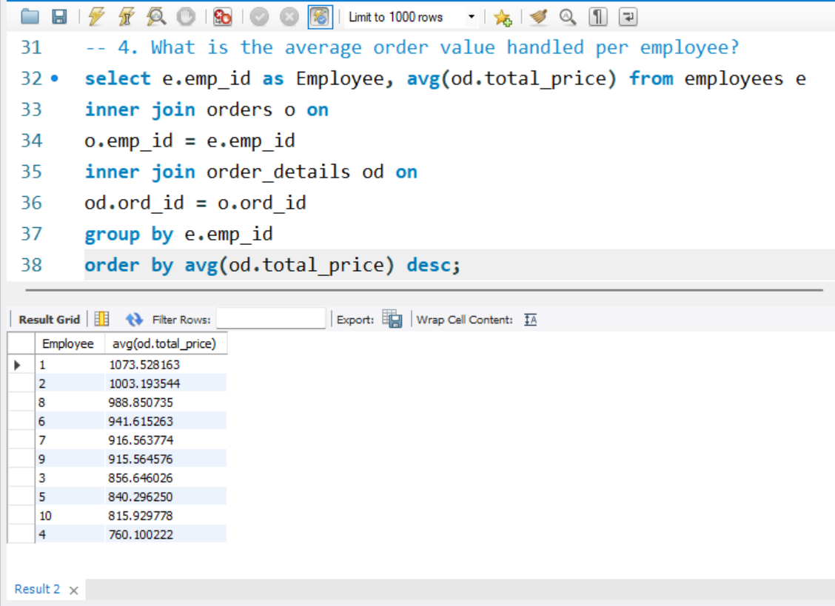
What is the average order value handled per employee?
To uncover the average order value handled per employee, you're essentially looking to measure how much revenue each employee is responsible for, on average. This is a powerful metric for evaluating performance, workload distribution, and even incentive planning.

Slide 18
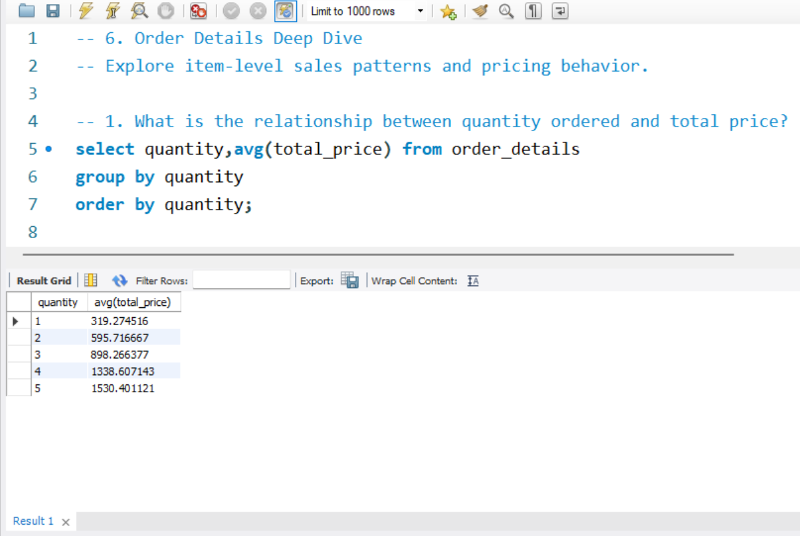
What is the relationship between quantity ordered and total price?
You’ll see a strong positive linear correlation between quantity and total price.
Customer behaviour like wholesale buyers, loyal customers. If total_price increase it could indicate premium pricing for bulk orders.

Slide 19
Final business insights and recommendations
Track sales and revenue
Monitor product availability
Analyze customer and employee activity
Improve operational efficiency

Slide 20
Conclusion
Using a dataset of Grocery store we provided the key insights of product performance, customer insights, supplier contribution, sales and order trends.
The analysis reveals a clear positive relationship between the quantity of items ordered and the total price, indicating that larger orders contribute significantly to overall revenue. This trend supports the importance of bulk purchasing behavior in driving sales performance.
The analysis demonstrates a strong positive correlation between the employees and sales that are generated to contribute total revenue of the store with tracking employee performance and customer behaviour order trends.

Slide 21
Challenges
Understanding table relationships and applying correct joins.
Ensuring data consistency with foreign key constraints.
Handling aggregation across joined tables.
Extracting time-based trends from date data
(especially if in VARCHAR format).

Slide 22
Q&A

Slide 23

THANK YOU

